Slide 1



Sri Lanka Insurance Corporation (SLIC)
Data Warehouse
Data Warehousing & Business Intelligence Presentation – MAHNDSE24.2

Slide 2

Team Members
01
02
03
04
T.H Wanniarachchi - MAHNDSE242F -006
Wagachchi S.P - MAHNDSE242F -007
B.S.M.A Samaranayake - MAHNDSE242F -015
K.T Wijeweera - MAHNDSE242F -017

Slide 3


Content
01
Introduction to the Dataset
02
Data Warehouse Design
03
ETL Process
04
Data Visualization & BI

Slide 4

Introduction to the Dataset
Sri Lanka Insurance Company generates vast data from policy sales, claims processing, premium payments, customer registrations, and policy lifecycle tracking.
Efficient data analysis is crucial to improve customer service, monitor regional policy uptake, identify payment trends, and boost operational efficiency.
This data warehousing project consolidates historical data from multiple sources to meet analytical needs.
The project uses simulated insurance data covering customer details, regional divisions, policy types, premium structures, claims, and payments.

Slide 5

Data Warehouse Design
Schema
Design
Life and Health Insurance Transaction Fact Table
Transaction_sk
Date_sk
Customer_sk
Policy_sk
Policytype_sk
Agent_sk
Employee_sk
Branch_sk
Location_sk
Premium_amount
Life_benefit_payout_amount
Health_benefit_payout_amount
Policies_issued_count
Policies_renewed_count
Claim_count, Transaction_ type
Agent Performance Fact Table
Agent performance_sk
Date_sk
Agent_sk
Policytype_sk
Branch_sk
Policies_sold_count
Total_premium_collected
Agent_commission_earned
Customer_acquired_count

Slide 6
Schema Design
General Insurance Transaction Fact Table
General_transaction_sk
Date_sk
Customer_sk
Policy_sk
Policytype_sk
Agent_sk
Employee_sk
Branch_sk
Location_sk
Vehicle_sk
Premium_amount
Claim_amount_paid
Claim_count
Policies_issued_count
Policies_renewed_count
Transaction_type
Dim_Agent
Agent_sk
Agent_id
Agent_name
Agent_type
Contact_number
Email
Recruitment_date
Agent_status

Slide 7
Schema Design
Dim_Customer
General_transaction_sk
Customer_sk
Customer_id
First_name
Last_name
Full_name
Date_of_birth
Age
Age_group
Gender
Address
City
District,
Province
Contact_number
Email
Customer_segment
Occupation
Marital_status
Health_condition_details,
Has_pre_existing_condition
Height_cm
Weight_kg
Has_valid_driving_license
License_issue_date
License_expiry_date
Dim_Branch
Branch_sk
Branch_id
Branch_name
City
District
Region
Branch_contact_number

Slide 8
Schema
Design
Dim_Employee
Dim_Location
Employee_sk
Employee_id
Employee_name
Job_role
Department
Branch_sk
Employment_status
Location_sk
City
District
Province
Country
Postal_code
Region_type
Dim_Date
Date_sk
Full_date
Day_of_week
Day_of_month
Month
Month_name
Quarter, Year
Fiscal_year
Is_holiday
Weekend_flag
Dim_Policy Type
Policytype_sk
Policytype_id
Type_name
Category
Sub_category
Description

Slide 9
Schema Design
Dim_Vehicle
Vehicle_sk
Vehicle_id
Vehicle_registration_no
Vehicle_make
Vehicle_model
Manufacturing_year
Vehicle_type
Engine_capacity_cc
Fuel_type
Transmission_type
Seating_capacity
Vehicle_current_value
Dim_Policy
Policy_sk , Policy_id
Policy_number
Policy_name
Issue_date
Start_date
End_date
Policy_duration_years
Policy_status
Sum_assured
Premium_frequency
Renewal_option

Slide 10

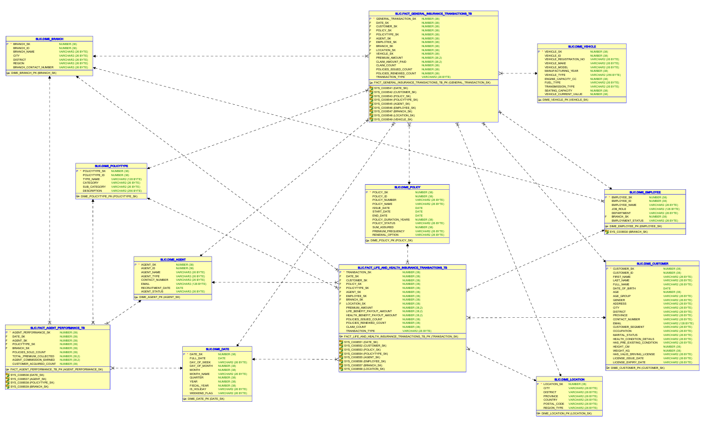
Data warehouse schema(Galaxy)

Slide 11
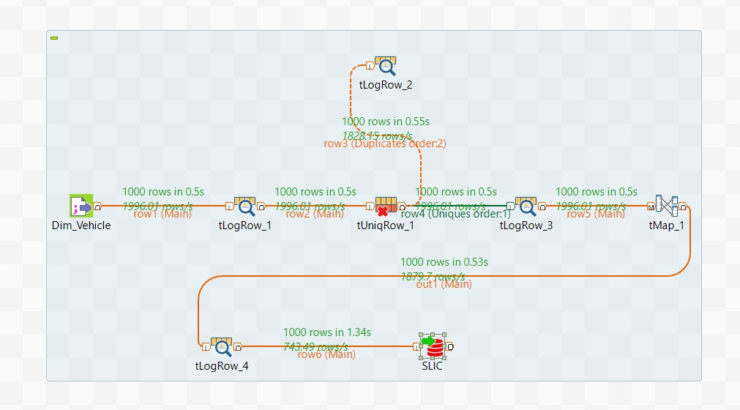
ETL Process
Dimension Table : Vehicle

Slide 12
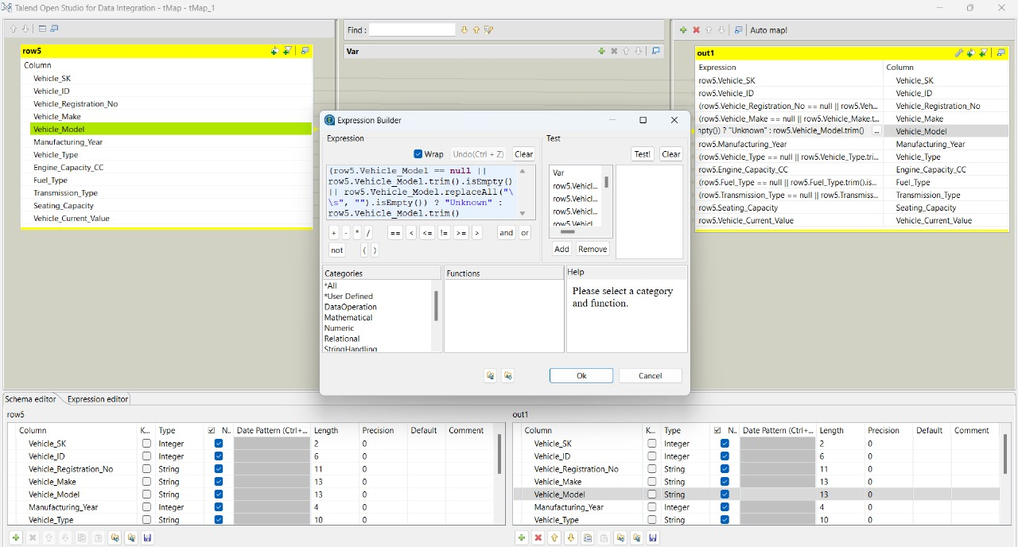
Dim Vehicle missing values handling strings

Slide 13
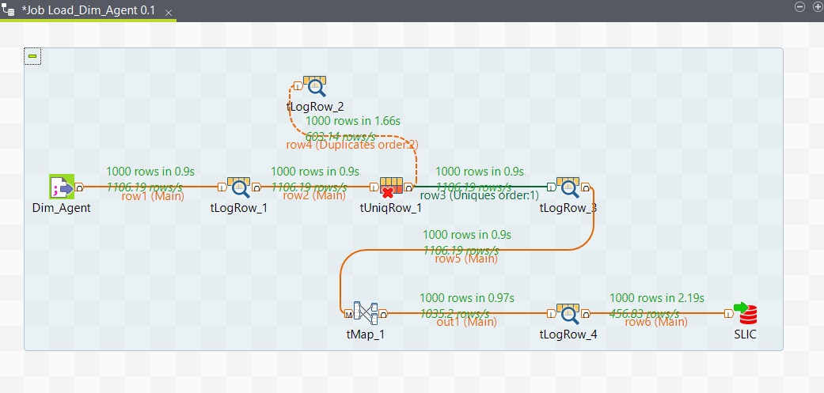
Dimension Table : Agent

Slide 14
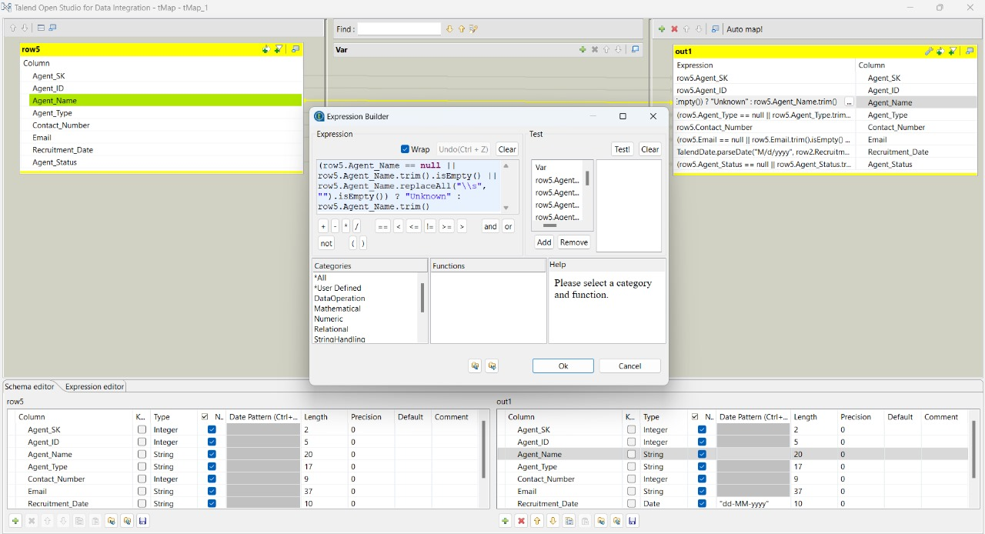
Dim Agent missing values handling strings

Slide 15
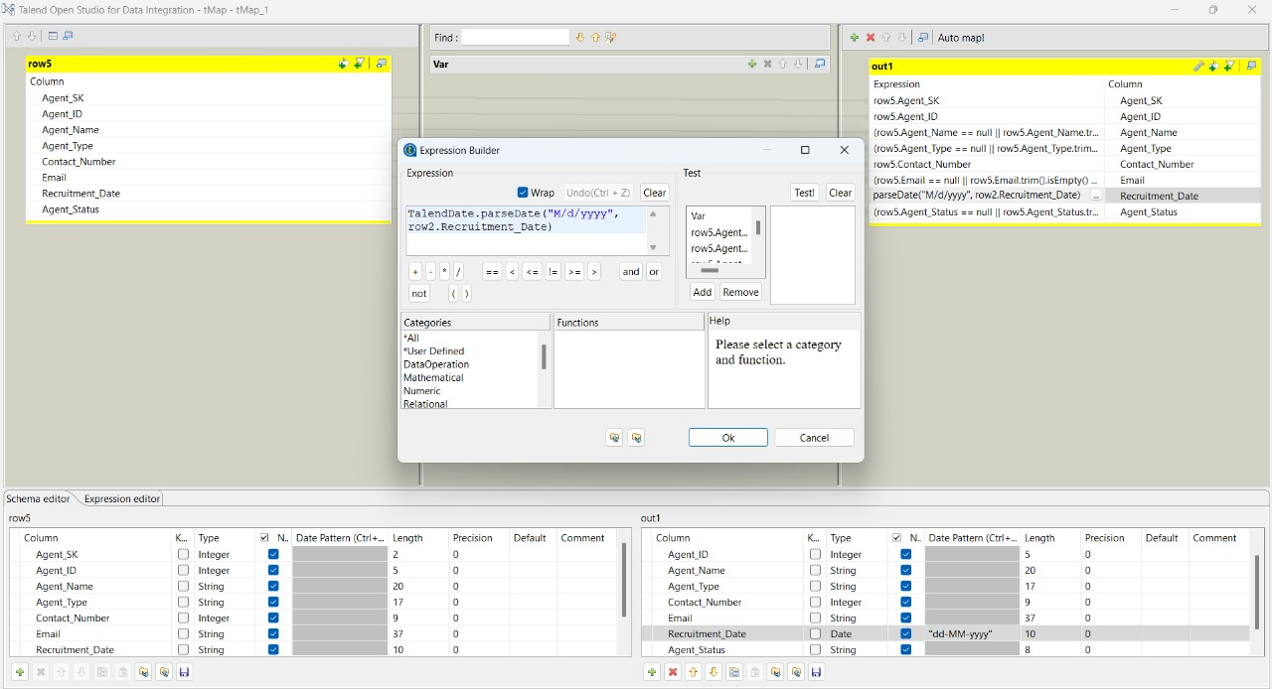
Dim Agent convert recruitment date data type STRING to DATE

Slide 16
Same procedure is applied to
Dim
Dim_Branch
Dim
Dim_Date
Dim
Dim_Employee
Dim
Dim_Location
Dim
Dim_Policy
Dim
Dim_Vehicle
Dim
Dim_Policy_Type

Slide 17
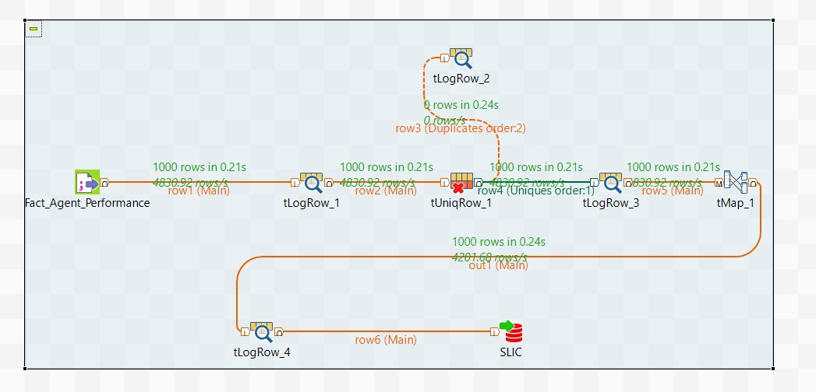
Fact Table : Fact Agent Performance

Slide 18
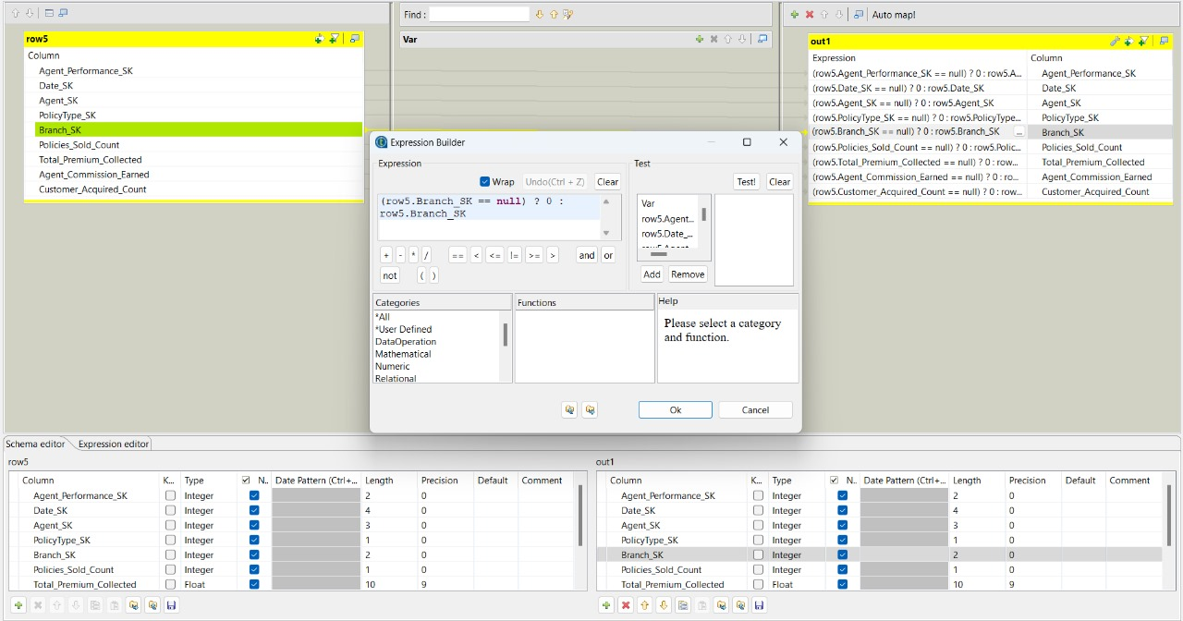
Fact Agent performance missing values handles integer

Slide 19
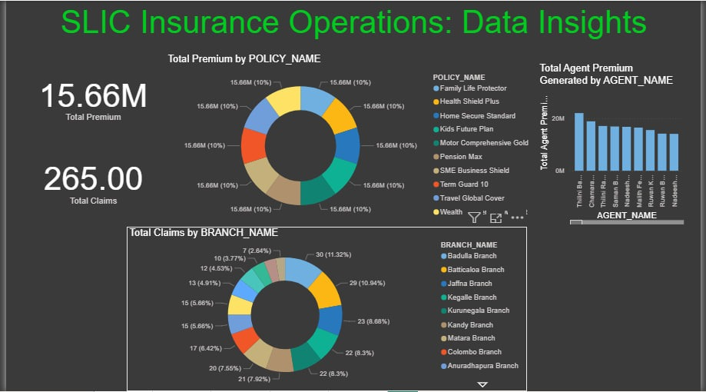
Data Visualization & BI
SLIC Insurance Operations: Data Insights

Slide 20
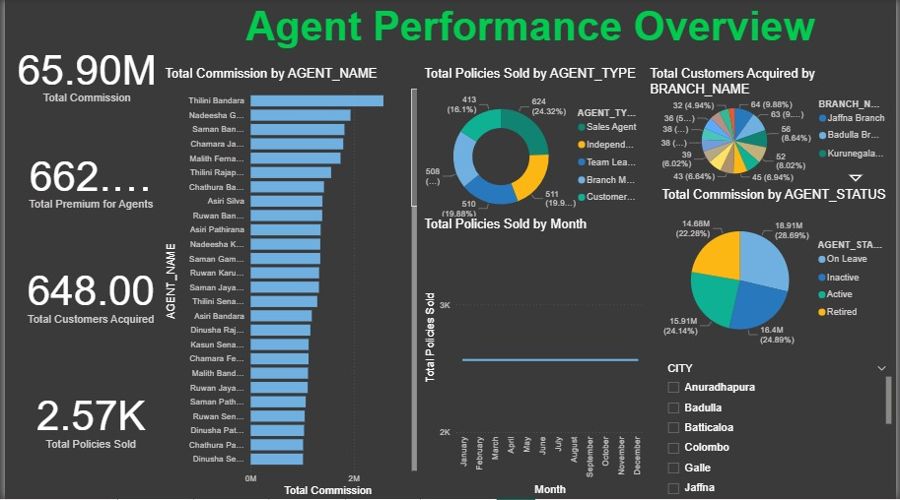
SLIC Agent Performance Overview

Slide 21
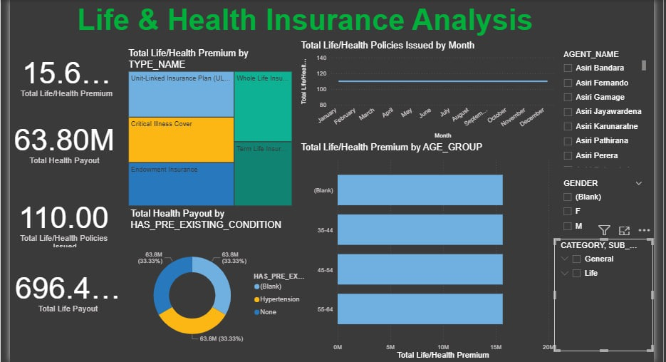
Life And Health Insurance Analysis

Slide 22


Slide 23


